Slide 1
Case Study on M-estimation for Mitigating Data Poisoning Attacks
Shameek Bhattacharjee
Western Michigan University
This material is a deliverable of NSF OAC – 2017289 and SATC 2030611
The study appeared as a paper in ACM CPSS 2022 and was result of a class project with students
Mohammad Jaminur Islam and Sahar Abedzadeh

Slide 2

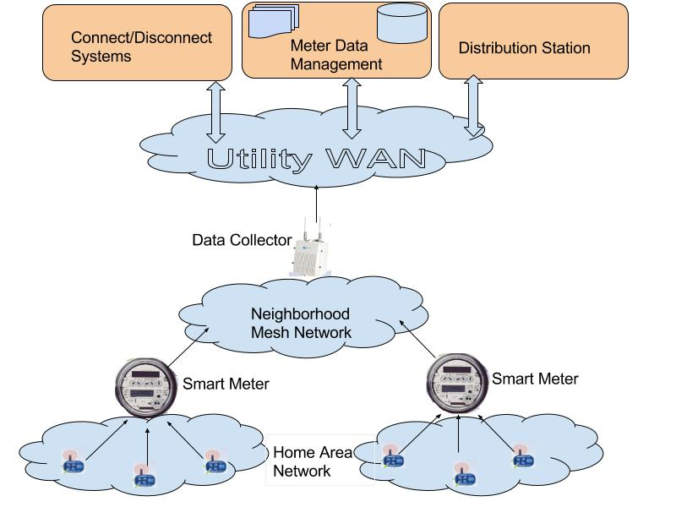
CPS Proof of Concept - Advanced Metering Infrastructure
Smart meters automatically sense power consumption from customers and periodically send it to utility.
Smart Meter Data used for billing, power distribution, demand response in smart grids
Integrity of smart meter data is crucial
Anomaly based Attack Detectors have been developed
Data Falsification
Nan Gateway
Demand Response / Pricing Signals
Physical
Consumption
Data Sent Periodically
Cyber
Smart Appliances/ Loads
Notes:
Smart meters analogous to the CPS sensors which are known to be prone to cyber and physical exploits that lead to data falsification attacks. This will result in wrong billing, wrong pricing signals, and remote disconnect decisions in demand response systems that depend on the AMI data. Naturally, like an CPS sensing control loop, you need anomaly based attack detection.

Slide 3
Anatomy of Anomaly based Attack Detectors in CPS
Raw Data
From IoT Devices
Invariant
Generation
Stateless Residual
Stateful Residual
Learning of thresholds on Stateful Residuals
Latent Space
Assumption:
No attacks are present during learning of invariants
and stateful residuals
The learning thresholds of anomaly detection is accurate
Deployment
Anomaly Detection Criterion
Notes:
Learning of the threshold bounds of invariants/stateless residuals key to anomaly-based attack detection accuracy

Slide 4
Problem being solved and Main Contribution
Problem Statement
Data poisoning attacks → are data falsification attacks during the training phase
→ biases invariants and stateless residuals → learned thresholds
→ degrade performance of anomaly-based attack detection frameworks
A case study on smart metering infrastructure
Main Contribution
Design two data poisoning attacks against anomaly-based attack detector.
Analyze root cause of vulnerability of regression-based threshold learning
Robustifying anomaly detection frameworks that detect data integrity attacks
- By switching to robust loss functions and changing regression type
Compare how regression type and loss functions impact mitigation of data poisoning attacks

Slide 5
Preliminaries on the Framework subjected to Data Poisoning Attack Bhattacharjee et. al., ACM Asia’CCS 2018, IEEE Trans. Dependable and Secure Comp. 2021

Slide 6
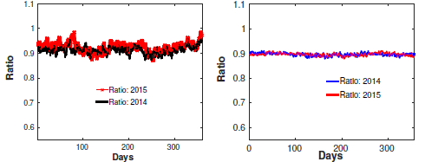



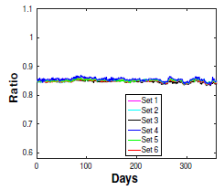

Invariant
Highly Stable Invariant across datasets
Special Signatures under attacks
Daily HM to AM Ratio (Q)
Hourly (t) Harmonic Mean
(T)
(T)
Texas Dataset: Years 2014 and 2015
Irish Dataset: 5000 meters from 6 Regions
in Dublin 2010
Hourly (t) Arithmetic Mean
S. Bhattacharjee et. al. “Detection and Forensics against
Stealthy Data Falsification in Smart Metering Infrastructure”,
IEEE Trans. on Depend. And Sec. Computing, 2021
(T)
Notes:
Note that it is on a logarithmic or power transformed scale

Slide 7
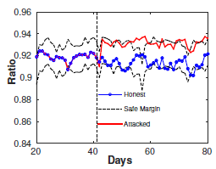
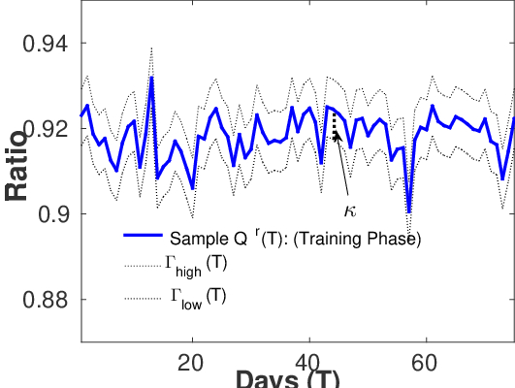
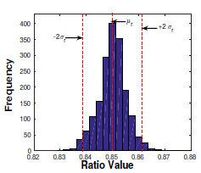
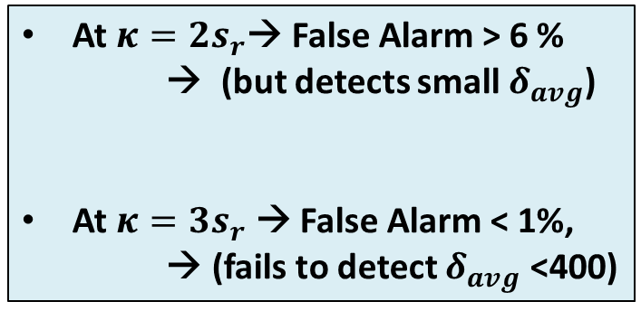
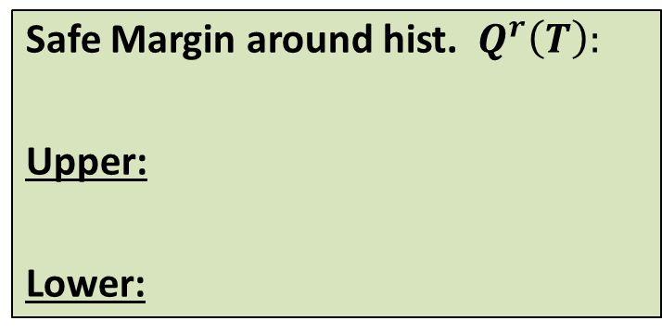


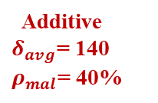
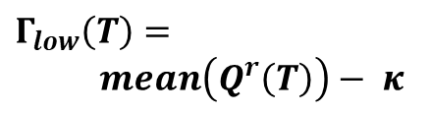
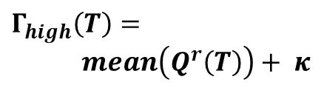
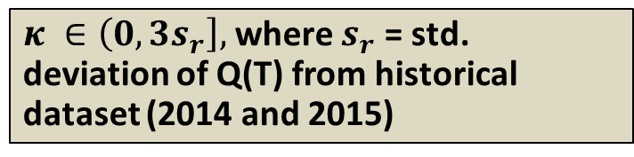
Stateless Residuals
Safe Margin around hist. $Q^{r}\left(T\right):$
Upper:
Lower:
$$Γ_{high}\left(T\right)=$$
$mean\left(Q^{r}\left(T\right)\right)+ κ$
$$Γ_{low}\left(T\right)=$$
$mean\left(Q^{r}\left(T\right)\right)− κ$
Additive
$δ_{avg}$= 140
$ρ_{mal}$= 40%
$κ ∈\left(0,3s_{r}\right],$where $s_{r}$ = std. deviation of Q(T) from historical dataset (2014 and 2015)
At $κ=2s_{r}$→ False Alarm > 6 %
→ (but detects small $δ_{avg}$)
At $κ=3s_{r}$ → False Alarm < 1%,
→ (fails to detect $δ_{avg}$ <400)
$$κ= +2s_{r}$$
Classical Problem
$$κ=−2s_{r}$$
Can we get best of both ???
How ?? → Stateful Residuals
Notes:
K = e.(standard deviation of the ratio sample)…. So e is the hyperparameter that you need to learn from a cross validation set.

Slide 8

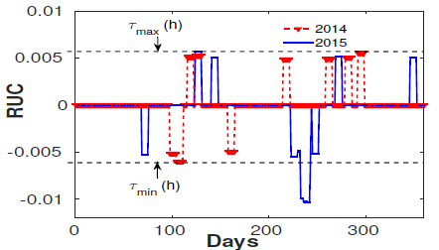

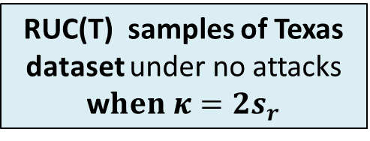
Stateful Residuals (RUC) → Latent space for detection threshold learning
(Signed) Residual between Ratio Metric and Safe Margins at (Window) T:
Short Term Memory of Deviations
Learned Candidate Thresholds
Attack
Widening
The
Thresholds
Will
Cause
Missed
Detection
Sum of Residuals under Ratio Curve at any T
FS = is a sliding frame of past multiple days
Long Term Memory
At every window T, store RUC samples from training sets
Find the threshold margins of
RUC(T) from Training Sets
RUC(T)→ low (no attacks), high (attacks)
RUC(T) samples of Texas dataset under no attacks w$hen κ=2s_{r}$

Slide 9
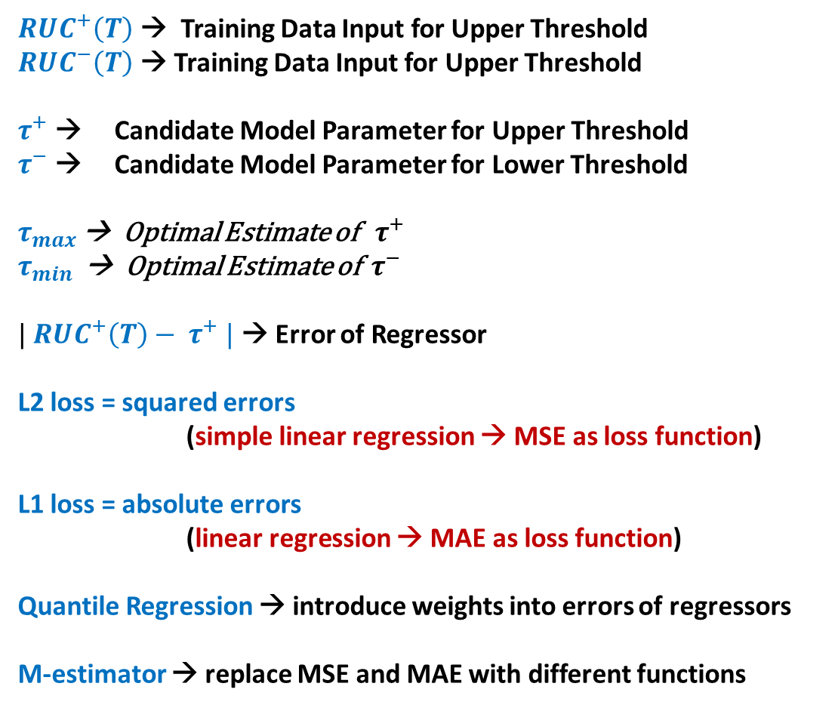
Notations and terminologies
${RUC}^{+}\left(T\right)$ → Training Data Input for Upper Threshold
${RUC}^{−}\left(T\right)$ → Training Data Input for Upper Threshold
$τ^{+}$ → Candidate Model Parameter for Upper Threshold
$τ^{−}$ → Candidate Model Parameter for Lower Threshold
$τ_{max }$→ Optimal Estimate of ${ τ}^{+}$
$τ_{min }$ → Optimal Estimate of ${ τ}^{−}$
$| {RUC}^{+}\left(T\right)− τ^{+} |$ → Error of Regressor
L2 loss = squared errors
(simple linear regression → MSE as loss function)
L1 loss = absolute errors
(linear regression → MAE as loss function)
Quantile Regression → introduce weights into errors of regressors
M-estimator → replace MSE and MAE with different functions
Some Observations
Errors are not gaussian
The variance in errors not constant
Simple Linear Regression is not the best choice
Add data poisoning to it, and the need for a novel design becomes inevitable

Slide 10
Discussing the Attacks

Slide 11
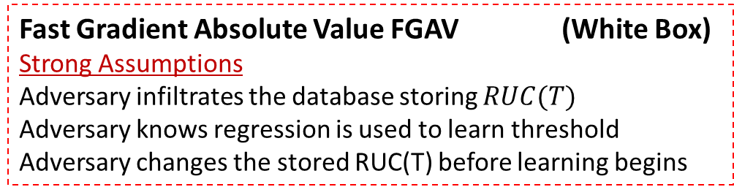
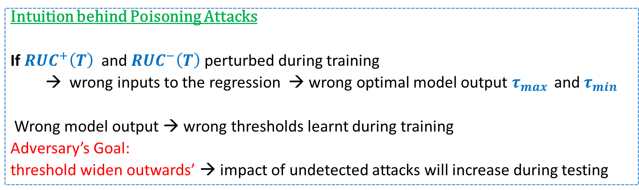
Data Poisoning Attacks
Intuition behind Poisoning Attacks
If ${RUC}^{+}\left(T\right)$ and ${RUC}^{−}\left(T\right)$ perturbed during training
→ wrong inputs to the regression → wrong optimal model output $τ_{max }$ and $τ_{min }$
Wrong model output → wrong thresholds learnt during training
Adversary’s Goal:
threshold widen outwards’ → impact of undetected attacks will increase during testing
Fast Gradient Absolute Value FGAV (White Box)
Strong Assumptions
Adversary infiltrates the database storing $RUC(T)$
Adversary knows regression is used to learn threshold
Adversary changes the stored RUC(T) before learning begins
Two Attacks Implemented
Random Smart Meter Level Poisoning (RSL) (Black Box)
Less Strong Assumptions
Adversary controls a small subset of compromised sensors
Falsifies data during training from that subset

Slide 12
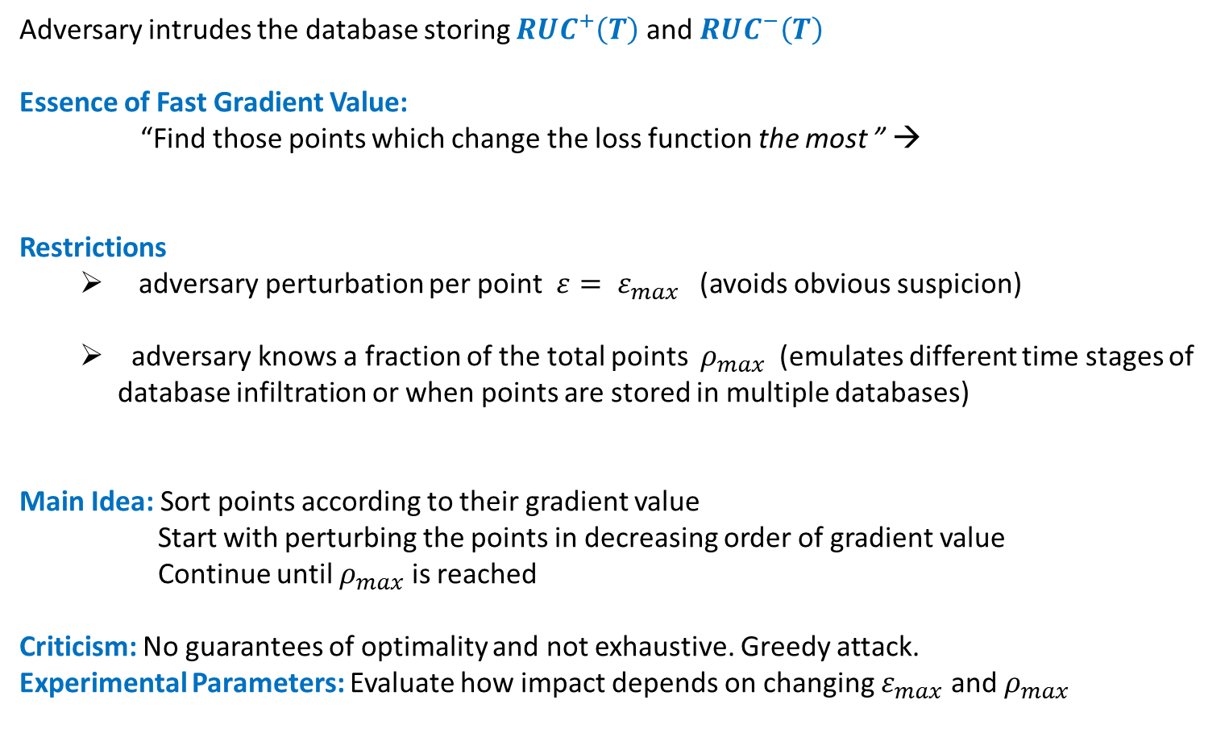
Fast Gradient Absolute Value (FGAV)
Gradient of Loss Function
w.r.t. the training input
Adversary intrudes the database storing ${RUC}^{+}\left(T\right)$ and ${RUC}^{−}\left(T\right)$
Essence of Fast Gradient Value:
“Find those points which change the loss function the most ” →
Restrictions
adversary perturbation per point $ε= ε_{max}$ (avoids obvious suspicion)
adversary knows a fraction of the total points $ρ_{max}$ (emulates different time stages of database infiltration or when points are stored in multiple databases)
Main Idea: Sort points according to their gradient value
Start with perturbing the points in decreasing order of gradient value
Continue until $ρ_{max}$ is reached
Criticism: No guarantees of optimality and not exhaustive. Greedy attack.
Experimental Parameters: Evaluate how impact depends on changing $ε_{max}$ and $ρ_{max}$
I. Goodfellow, et. al., “Explaining and harnessing adversarial examples", ICLR, 2015, and similar works of Tramer ICLR, 2018.

Slide 13
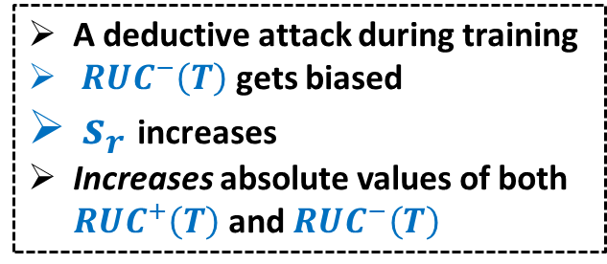
Random Smart Meter Level Poisoning (RSL)
Exploit: Adversary compromises a subset of smart meters during training
Random Data Falsification of a certain attack type (e.g. deductive shown below)
A deductive attack during training
${ RUC}^{−}\left(T\right)$ gets biased
$s_{r}$ increases
Increases absolute values of both ${RUC}^{+}\left(T\right)$ and ${RUC}^{−}\left(T\right)$
Biased inputs
to regression
learning
A wider threshold than actual threshold
Causes Undetected Attacks During Testing
Adversary does not require model knowledge
Adversary does not require database access

Slide 14
Defense and Mitigation

Slide 15
Mitigation Framework Against Poisoning
Q1: How does Regression Type
Affect Anomaly Detection Performance?
Simple Regression
(Unweighted Errors)
Quantile Regression (proposed) (Weighted Errors dependent on Sign)
Q2: How does Loss Function Choice
Affect Anomaly Detection Performance?
L2 (mean of squared errors)
L1 (mean of absolute errors)
M-estimators (mean of special error functions)
Huber Loss (proposed)
Cauchy-Lorentz Loss (proposed)
Q3: How to Combine Q1 and Q2
Into one framework
Form threshold learning algorithms
resilient to different poisoning attacks
Resilient means
Less Impact of Undetected Attacks in the
Presence of attacks
Low false alarm in the absence of data
Poisoning and any attack

Slide 16
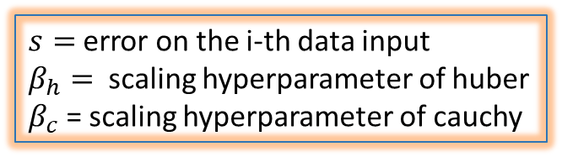
M-estimators → Robust Loss Functions
Huber Loss
Cauchy Lorentz Loss
$s=$error on the i-th data input
$β_{h}=$ scaling hyperparameter of huber
$β_{c}$ = scaling hyperparameter of cauchy
Cauchy and Huber IF
grows slower than L2
Cauchy IF grows slower than Huber
Influence Function
Gives rate of change
in an estimator given a
Small change in the input

Slide 17


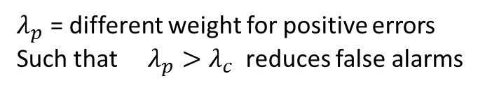
One of the combined Algorithms
Regression Type: Quantile Weighted (QW)
Loss Function Type: Cauchy Loss
$λ_{c}$ = different weight for negative errors
$S^{+}$= corresponding weighted error
Loss Function value
by Cauchy Loss
$λ_{p}$ = different weight for positive errors
Such that $λ_{p}>λ_{c}$ reduces false alarms
Total Four Algorithms Proposed
QW-CAUCHY
QW-Huber
NW-CAUCHY
NW-Huber
Optimal Upper Threshold

Slide 18
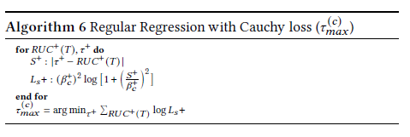
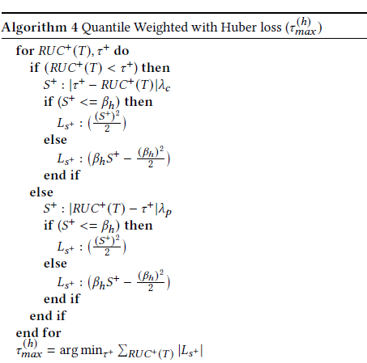
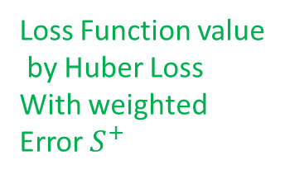

Other Mitigations Proposed
Non-quantile
Regression with Cauchy Loss
Weighted error $S^{+}$
Loss Function value
by Huber Loss
With weighted
Error $S^{+}$
Non-quantile
Regression with Huber Loss

Slide 19
Metrics
# of Compromised Meters In test set
Electricity Price Per KWh
Impact of Undetected Attack
# of readings per day
# of days attack
Was launched
Data falsification margin in test set
Expected Time Between False Alarms
Time Between Any
Two False Alarms
# of false alarm
pairs

Slide 20
Results under RSL
Goal: Compare Various Loss Functions
Control: Keep same regression type (Non- Quantile)
Conclusion: Cauchy has the lowest impact across
Goal: Compare Various Loss Functions
Control: Keep same regression type (Quantile)
Conclusion: Cauchy has the lowest impact across

Slide 21
Results under RSL contd…
Goal: Compare Quantile versus Non Quantile
Control: Keep same loss function
Conclusion: Non-Quantile is better than quantile
Goal: Effect of fraction of compromised meters
Control: Same margin of false data
Conclusion: Cauchy is better regardless

Slide 22
False Alarm Performance → RSL
Quantile versions of
L1 and L2
Quantile
Regression
Has better
False alarm
performance
Robustness
Comes at a
Cost of false
alarm
performance

Slide 23

Results under FGAV:
For small $α_{max}$
Impact versus Data Poisoning Strength
Goal: Compare Various Loss Functions
Control: Keep same regression type
Conclusion: Cauchy has the lowest impact compared to Huber for both quantile and non-quantile regression across varying poisoning and evasion strength
Goal: Compare Various Regression Types
Control: Keeping same loss function type
Conclusion: Non-Quantile Regression has lower impact of attacks compared to Quantile
Impact versus
Evasion Strength

Slide 24

Results under FGAV:
For medium $α_{max}$
Goal: Compare Various Loss Functions
Control: Keeping same regression type
Conclusion: Cauchy has the lowest impact compared to Huber for both quantile and non-quantile regression across varying poisoning and evasion strength
Goal: Compare Various Regression Types
Control: Keeping same loss function type
Conclusion: Non-Quantile Regression has lower impact of attacks compared to Quantile

Slide 25

Results under FGAV
For large $α_{max}$
Goal: Compare Various Loss Functions
Control: Keeping same regression type
Conclusion: Cauchy has the lowest impact compared to Huber for both quantile and non-quantile regression across varying poisoning and evasion strength
Goal: Compare Various Regression Types
Control: Keeping same loss function type
Conclusion: Non-Quantile Regression has lower impact of attacks compared to Quantile

Slide 26
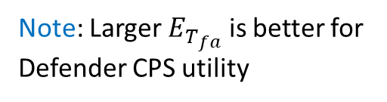
Results under FGAV →
False Alarm Performance Summary
Note: Larger $E_{T_{fa}}$ is better for
Defender CPS utility
Conclusions for FGAV:
Increased robustness of Cauchy and Huber M-estimator comes at the cost of false alarms
Keeping Cauchy as loss function, the quantile regression has slightly better false alarm performance
Keeping Huber as loss function, the quantile regression has slightly better false alarm performance
Huber has better false alarm performance than Cauchy

Slide 27
Base Rate False Alarm without Poisoning
In the fear of data poisoning we changed the design.
What if there is no actual poisoning??
How worse off are we with the new design in case of no-poisoning ?
Accounting for base rate fallacy,
Quantile Huber is a safer bet since
False alarm is comparable with L1 and L2
But gives lesser impact of undetected attacks as shown earlier.

Slide 28
Research funded by NSF grant SATC-2030611 and OAC-2017289

